Slide 1

B.Tech Project Presentation
on SOIL MONITORING SYSTEM
Presented by:
Gaurav Mathur(2019042011)
Bharat kumar Sahani(2019042010)
Preeti Vishwakarma(2019042019)
Priyanka kumari(2019042020)
Under Supervision
Dr. B.P. Pandey, Assistant Professor
Department of Electronics and Communication Engineering,
Madan Mohan Malaviya University of Technology, Gorakhpur (UP) , India

Slide 2
Outline of Presentation
Objective
Project Ideas
Block Diagram and Circuit Description
Technology and Components Used
BOM(Bill of Material) Cost
Differentiation of project
Hardware description
Conclusion and Future Scope
References

Slide 3
Objective
In India, agriculture is the need of most of the Indians livelihood and it is one of the main sources of livelihood. Agriculture also has a major impact on economy of the country. The consumption of water increases day by day that may leads to the problem of water scarcity. Now-a-days not only for crops ,outdoor plants in home becoming quite difficult for them.
The farmers from the remote locations would need go to the soil lab for soil testing to know about the soil fertility and required ratio of essential parameter such as Nitrogen, Phosphorus and Potassium(NPK).
Overall farmers faced various Problems while growing the crops so keep this problem in mind we are working on this project.

Slide 4
Project Idea
There are different options to solve our problem and these are the two that we investigated:
Soil Irrigation(Automatic Irrigation) :
The measurement of soil moisture will help us determine how much irrigation is required and which area require how much additional water content.
Soil parameter monitoring:
Monitoring of soil nutrients and soil moisture content helps control fertilizer application and promotes the optimal use of other natural resources.

Slide 5
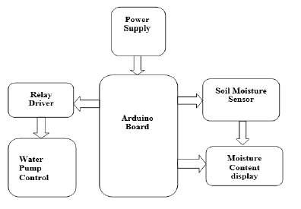
Block diagram
SOIL IRRIGATION SYSTEM

Slide 6
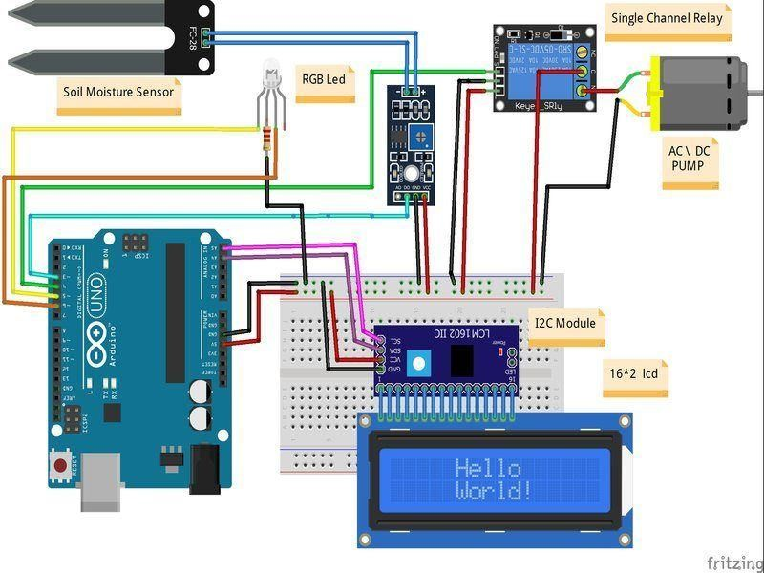
Circuit diagram
SOIL IRRIGATION SYSTEM

Slide 7
Block diagram
SOIL PARAMETER MONITORING SYSTEM
LCD Display
Node MCU
Temp. And humidity sensor

Slide 8
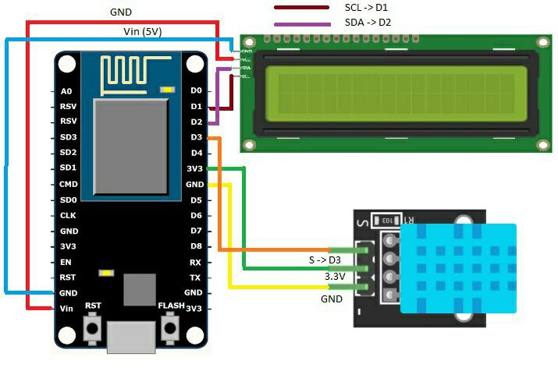
Circuit diagram
SOIL PARAMETER MONITORING SYSTEM

Slide 9
Components
Arduino Uno
Node MCU
Fc-28 Interface
DC motor
Soil Moisture Sensor
LCD Display
Single channel Relay Module
Temperature Sensor
NPK sensor
AC to DC Convertor
DC Motor driver
Breadboard
Connecting wires

Slide 10
BOM(Bill of Material) Cost
Components | Cost(Rs.)
Arduino Uno | 749
Node MCU | 170
Temp. And Humidity Sensor | 100
Soil Moisture Sensor | 100
I2C Module | 150
Single channel Relay | 120
LCD Display 16*2 | 300
Mini DC submersible Pump | 150
Voltage Regulator | 300
Box and Board | 200
Wires | 200
Total | 2539/-

Slide 11
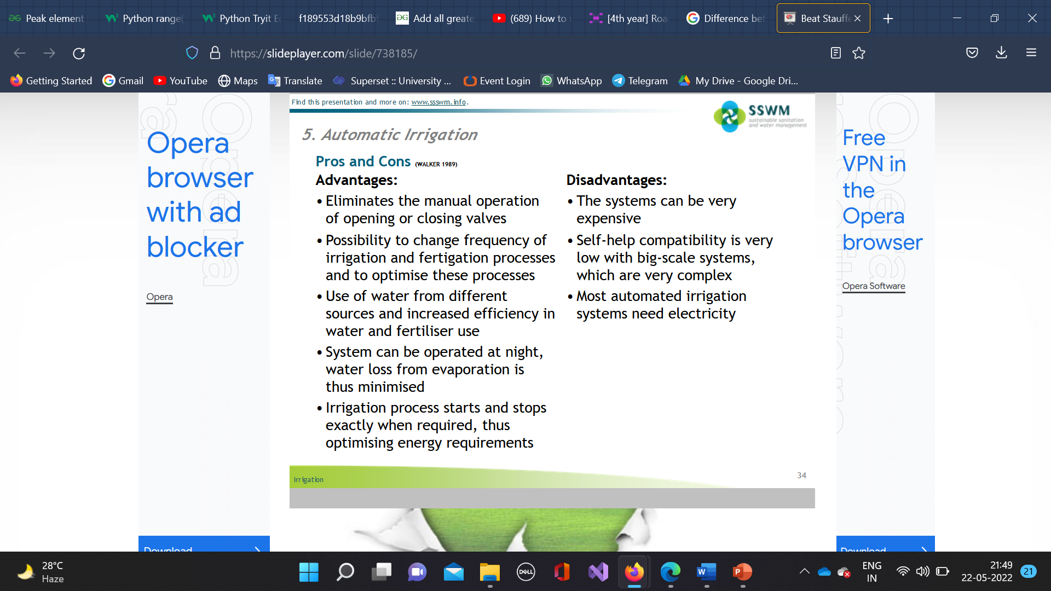
Difference between manually and automatic irrigation system
A manual irrigation system involves hand watering with hoses, nozzles, or sprinklers. While using these products tends to cost less money than installing an automatic system, it requires significantly more time as you will need to operate the equipment yourself.
An automatic irrigation system involves in-ground, clock-driven sprinklers that can run without human operation. The automatic system is ideal for large properties or when the homeowner travels or is unavailable to provide the necessary manual watering.

Slide 12
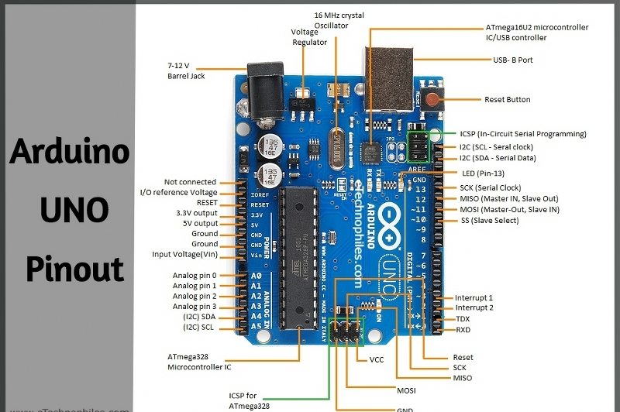
Hardware description
Arduino
A very small computer that can read input and transmit data to the output device.

Slide 13
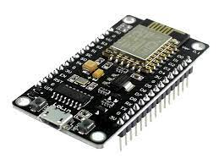
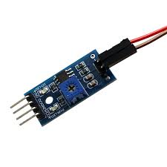
Node MCU
NodeMCU is an open source platform based on ESP8266 which can connect objects and let data transfer using the Wi-Fi protocol.
FC-28 Interface
It Provide Interface between Sensor And Arduino
It has four Pin i.e VCC ,GND, Analog And Digital in side of Arduino side.
There are two Pins on Sensor Side

Slide 14
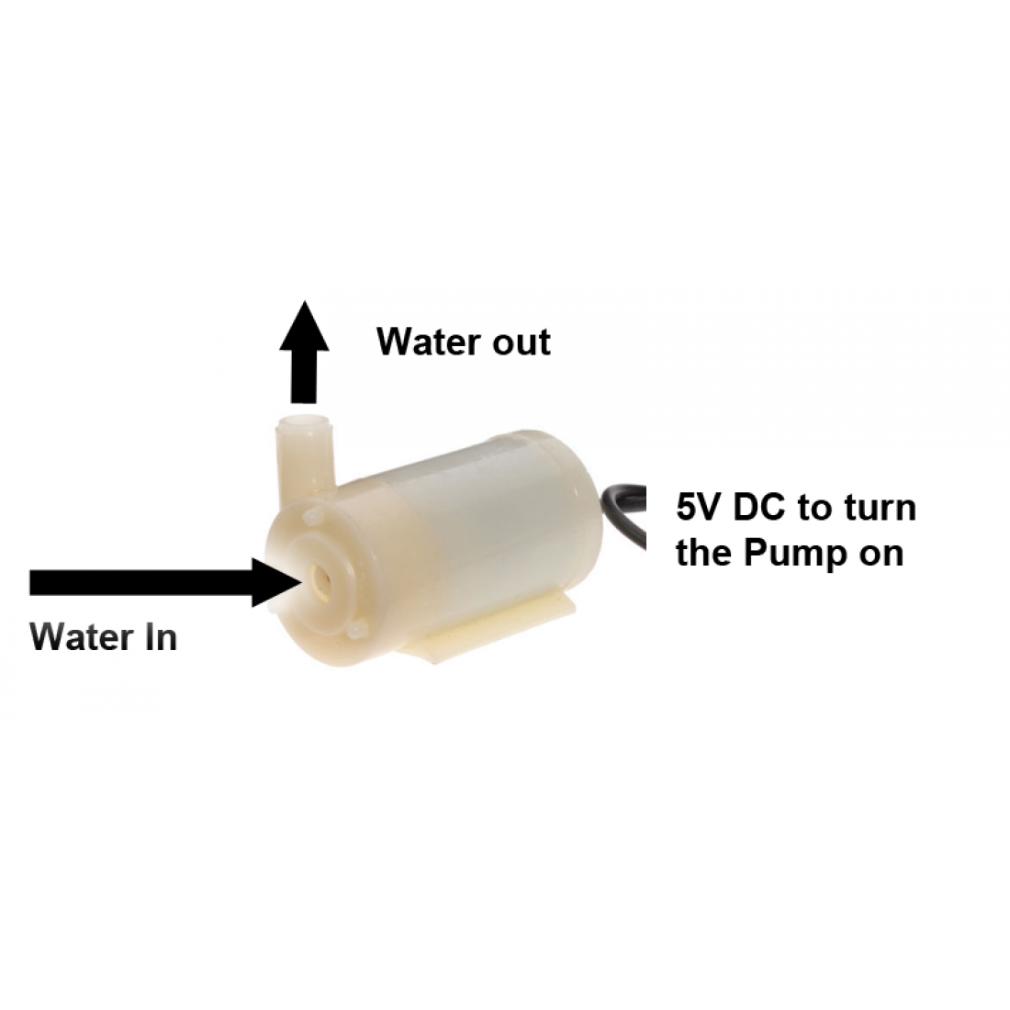
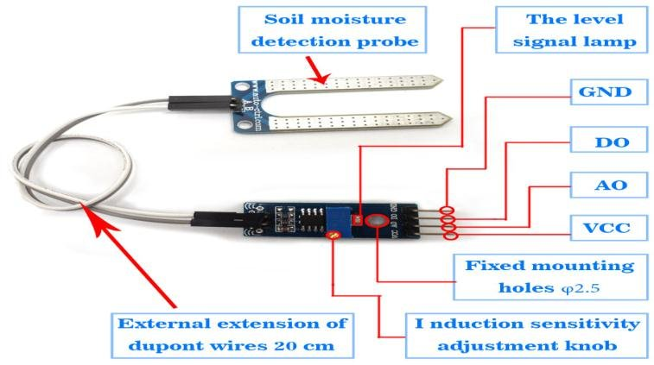
Mini DC Submersible Pump
This DC 3-6 V Mini Micro Submersible Water Pump is a low-cost, small-size Submersible Pump Motor that can be operated from a 2.5 ~ 6V power supply
Soil Moisture Sensor
Soil moisture sensors measure or estimate the amount of water in the soil. These sensors can be stationary or portables such as handheld probes.

Slide 15
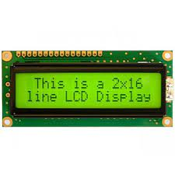
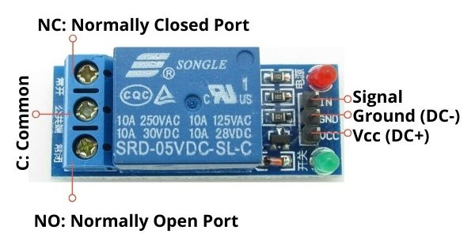
LCD Display
It is an array of small segments called pixels, which can be manipulated for information displaying.
Single Channel Relay Module
The Single Channel Relay Module is a convenient board which can be used to control high voltage, high current load such as motor, solenoid valves, lamps and AC load. It is designed to interface with microcontroller such as Arduino, PIC and etc.

Slide 16
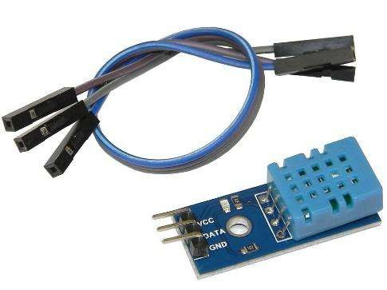
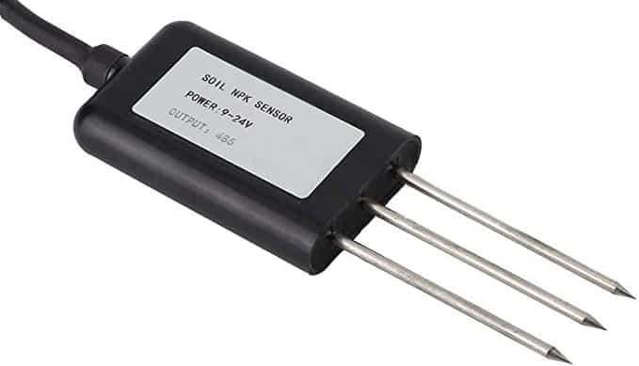
Humidity and Temperature Sensor
DHT11 sensor consists of a capacitive humidity sensing element and a thermistor for sensing temperature.
NPK Sensor
The soil NPK sensor is suitable for detecting the content of nitrogen, phosphorus, and potassium in the soil. It helps in determining the fertility of the soil thereby facilitating the systematic assessment of the soil condition.

Slide 17
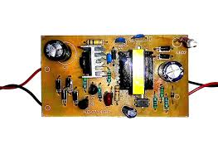
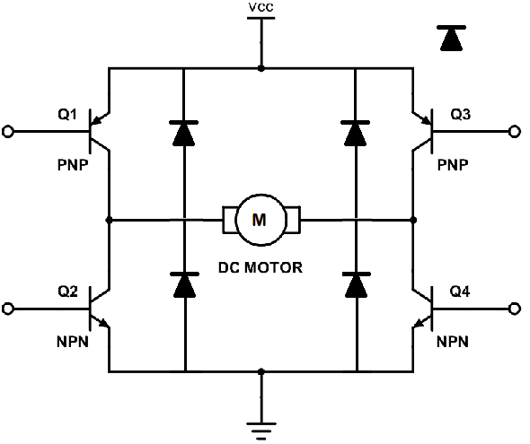
AC to DC Convertor
A device that converts an AC voltage to DC voltage is called an AC-DC Converter.
DC Motor Driver
The function of the circuit is to convert the low current signal to a high current signal.

Slide 18
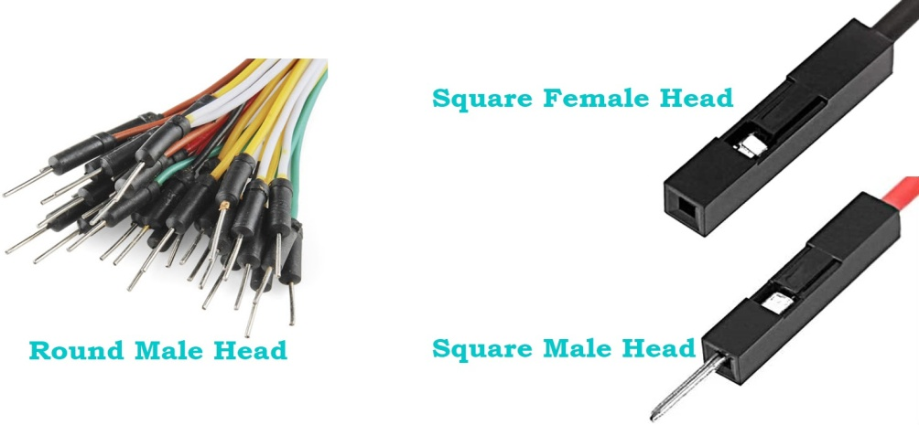
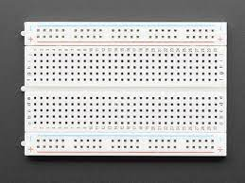
Connecting Wires
Jumper wires are used for making connections between items on your breadboard and Arduino's header pins. Use them to wire up all your circuits.
Breadboard
A breadboard allows for easy and quick creation of temporary electronic circuits or to carry out experiments with circuit design.

Slide 19
Programmable logic
START
COLLECTING INFO. FROM SENSOR
True
False
If(value>950)
Motor will on
Motor will off

Slide 20
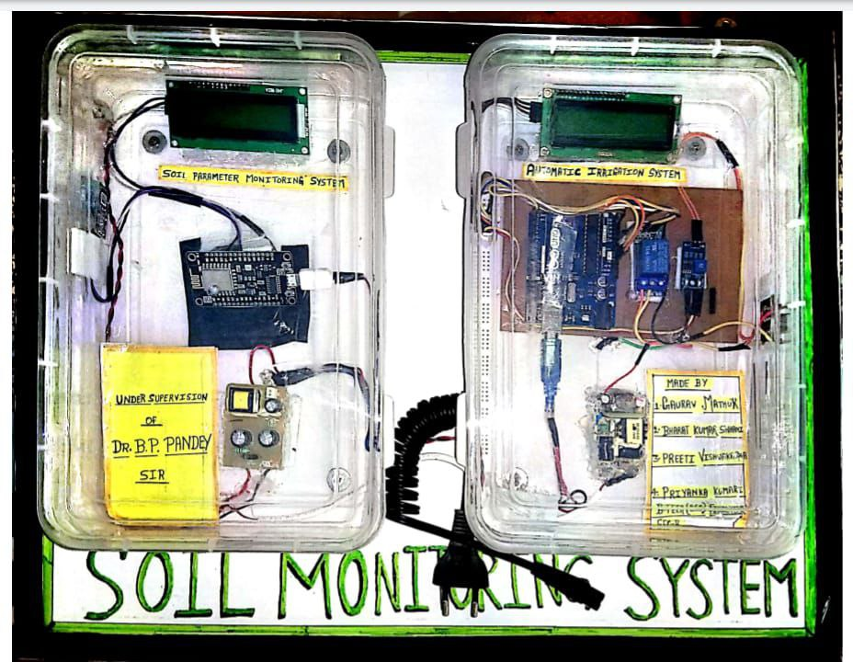

Slide 21
Conclusion
We can change the threshold value(In programming part) of the Soil Irrigation System according the given bellow table of the water requirement(mm) for the different types of Crops.
Crop | Water requirement(mm)
Rice | 1200-1400
Wheat | 450-650
Tomato | 600-800
Potato | 500-700
Maize | 500-800

Slide 22
Conclusion
Crops | Temperature(°c) | Humidity in %
Rice | 20-27 | 18-24
Wheat | 25-32 | 14-20
Tomato | 18-28 | 50-95
Potato | 25-30 | 65-70
Maize | 14-27 | 38-62

Slide 23
Conclusion
By using Temperature and humidity sensors which help to improve agricultural processes.
Plants need four things to survive: light, water, soil and air. However, to raise healthy plants, the most important element is the effect of water. Water is crucial in regard to relative humidity.
Relative humidity is a measure of how much water the air can hold at any given temperature. This means that say the air is at 60% humidity at 20 degrees, then the air is at 60% of its total moisture capacity for that temperature.
Most flowering plants prefer the same daytime temperature range, but grow best when nighttime temperatures range from 55 degrees to 60 degrees F.
We can protect our crop or agriculture field by low and high temperature and humidity which create the bad effect on agriculture field.
We can also connect the NPK sensor in the SOIL PRAMETER MONITORING SYSTEM with DHT-11 and NODE MCU which can help to know the ratio of NPK in the Soil. According to the NPK ratio in soil we can also recommended FERTILIZERS for enhancing the overall growth of Crop and maintain Soil Fertility.
By using this System Farmers are no need go to the soil lab for soil testing.

Slide 24
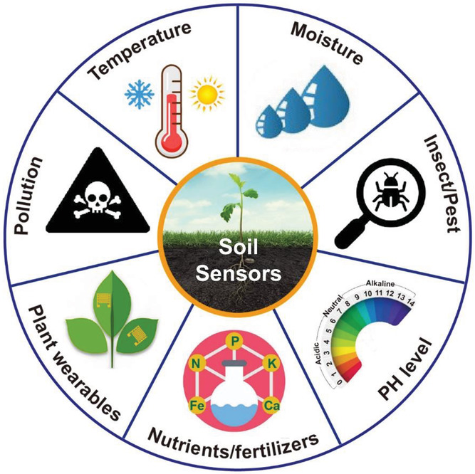
Advantages
Saves you water and time
Reduces weed growth.
Improves plant growth
Preserves soil nutrients
Increasing the farmer profitability
The smart irrigation system is user friendly platform to learn and enhance your skill about smart watering system.
It can provide high accuracy water supply and avoid water from wastage.
Due to automatically handling, user requires less man power.
With the help of the sensors, it can accurately determine the soil moisture levels.
It can easily detect and control the temperature, humidity, solar radiation using sensors.
This system automatically provides water supply to the field. User can manually operate (turn ON or OFF) valve.
This system helps to produce good quality of crops and improves economic condition.

Slide 25
Future scope
The project can be used as a base for realizing a scheme to be implemented in other projects of great level such as weather forecasting, temperature updates, device synchronization ,etc.
The project itself can be modified to achieve a complete Home Automation.
Pesticides & fertilizers can also be added automatically in the water.
GSM can be added for sending SMS to the concerned person in case of any problem.
To provide protection from insect attack for better yield. Focused on the prevention of crops from insect attack which damages the crop leaves and root so it automatically affects the crop yield.
To observe other parameters for better yield. Climatic conditions also affect the growth of crops, like temperature increases the water requirement also increases so it can also be monitored.

Slide 26
References
https://stirringthepyramid.wordpress.com/2014/08/12/how-many-farmers-does-india-have-or-what-percents
https://www.gardeningknowhow.com/garden-how-to/soil-fertilizers/fertilizer-numbers-npk.htmnpk importance
R Sindhuja- Soil Nutrient Identification Using Arduino- Asian Journal of Applied Science and Technology

Slide 27

Thank You

